Slide 1
CSE 226: Digital Logic Design Lab Latches and Priority Encoder United International University

Slide 2
Objective
Implement latches in trainer board
Ripple Counter: 4-bit Upward Counter

Slide 3
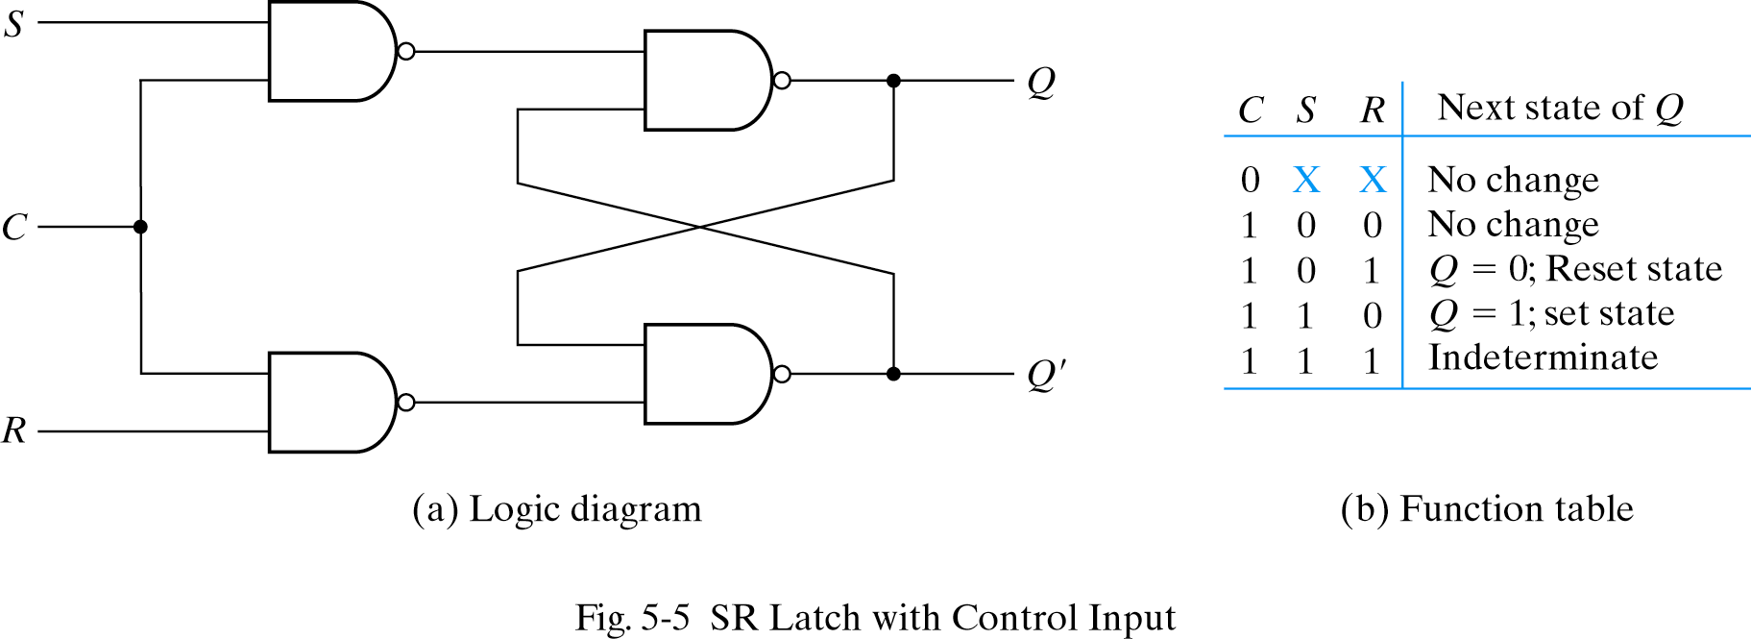
Clocked S - R Latch
Avoid uncontrolled latch changes
C = 0 disables all latch state changes
Control signal enables data change when C = 1

Slide 4
D Latch
Adding an inverter to the S-R Latch, gives the D Latch:
Note that there are no “indeterminate” states!
D
Q
C
Q
Q
D
Q(t+1)
Comment
0
0
0
No change
0
1
1
Set Q
1
0
0
Clear Q
1
1
1
No Change

Slide 5
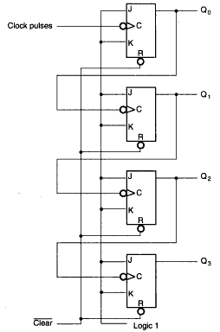
Ripple Counter: 4-bit Upward Counter
Remember J-K toggles when both J and K are ‘1’
The bubble on the clock means negative-edge triggered
When Q0 goes from ‘1’ to ‘0’ (as if a negative-edge has been triggered to clock of Q1), Q1 toggles
When Q1 goes from ‘1’ to ‘0’, Q2 toggles
When Q2 goes from ‘1’ to ‘0’, Q3 toggles

Slide 6
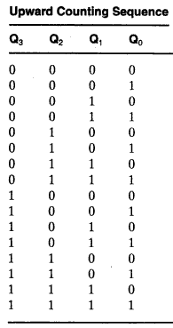
Ripple Counter: 4-bit Upward Counter
When Q0 goes from ‘1’ to ‘0’ (as if a negative-edge has been triggered to clock of Q1), Q1 toggles
When Q1 goes from ‘1’ to ‘0’, Q2 toggles
When Q2 goes from ‘1’ to ‘0’, Q3 toggles
What about the last sequence: how it goes from ‘1111’ to ‘0000’?

Slide 7
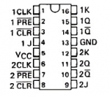
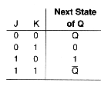
7476: Dual J-K Flip-Flops With Preset And Clear

Slide 8
Writing report
All the diagrams
Functional tables
Logic diagrams
ICs being used

